Slide 1
Quantum Basin Intelligence (QBI) Drill Out Model v0
Mar 2024

Slide 2
Agenda
1
Objective, Scope & Approach
2
Methodology
3
Cycle Time Model Overview and EDA
4
Cycle Time Model Finding & Assumptions
5
Rigs Model Overview, Finding & Assumptions
6
Drilling and Scheduling Model Overview
7
Production Estimation Model Overview
8
Production Estimation Model Results
7
Next Steps

Slide 3


Overview
Objective & Scope
Build a model to predict the development and production from a basin.
Approach
Create a rule-based model that utilizes rig data and historical information to obtain diverse cycle times and production dates for inventories. The objective is to gather details at the type curve level and incorporate
Qcast forecast information.

Slide 4




Methodology
Drill Out Model
Cycle Time Model
Rigs Model
Drilling and Scheduling
Production estimation
This model has the capability to extract distinct cycle times for each well at operator and type curve levels.
This model forecasts the number of rigs in a type curve for a specific operator.
This model identifies the dates for drilling, completion, and production of wells (WIPs and Undev).
This model forecasts the total amounts of oil, gas and water production in the entire basin, as well as in each type curve area, for a specified time period.

Slide 5
Model : Cycle Time Model
Permit submission
Permit Approval
Spudding Starts
Rig Release
Well Completion
Production Starts
Cycle Time Model
Cycle Time model determines the time duration for the following stages
for each operator within each Type Curve area by analysing historical data:
Time taken from permit submission to permit approval.
Time taken from permit approval to spud.
Time taken from spud to rig release.
Time taken from rig release to well completion.
Time taken from well completion to first production.

Slide 6
Cycle Time Model (Gulf Coast East basin)
Data Sources
Well completions data
Basin = Gulf Coast East
Hole Direction = H
FPD>
1 Jan 2019
2543
API10
Well Data
Type curve Data
Well Completions
Analog Well Selection
Key Highlights
Total unique API10 = 4135
Total unique Operators = 108.
Total unique Type Curve Area = 30.

Slide 7
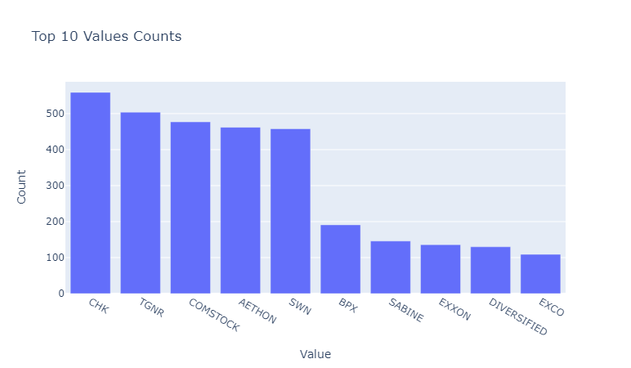
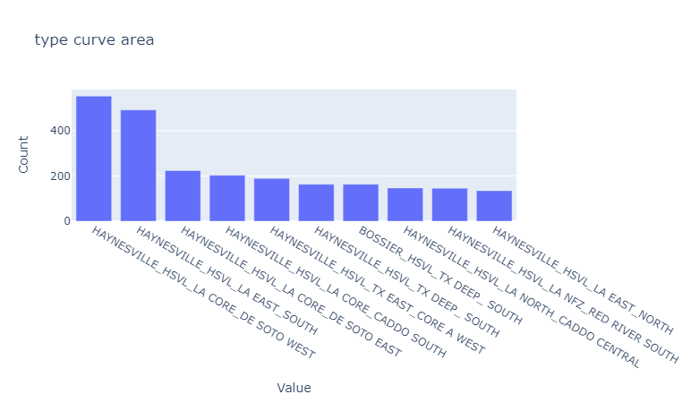
Cycle Time Model - EDA
Top 10 Operators and total num of wells
Top 10 Type curves and total num of wells

Slide 8
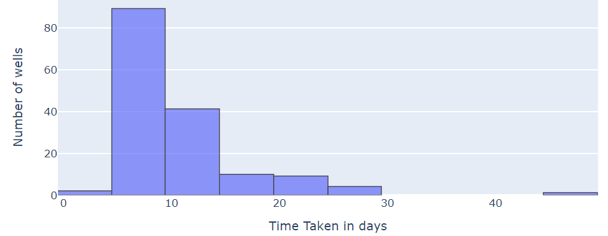
Model : Cycle Time Model- EDA
Permit Submit to Permit Approval Cycle Time

Slide 9
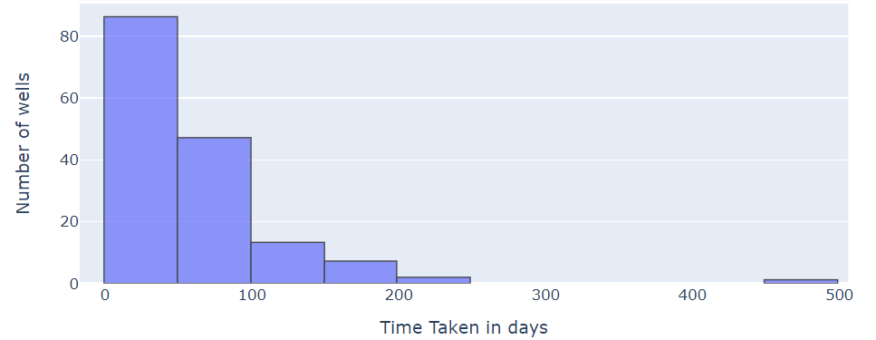
Model : Cycle Time Model - EDA
Permit Approval to Spud Cycle Time

Slide 10
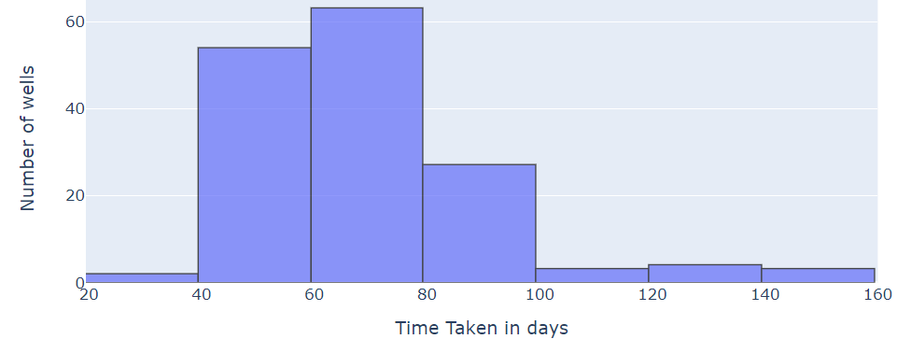
Model : Cycle Time Model - EDA
Spud to Rig Release Cycle Time

Slide 11
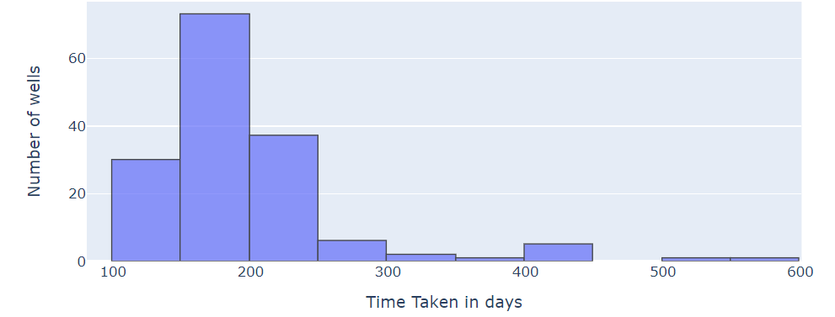
Model : Cycle Time Model - EDA
Rig Release to Completions Cycle Time

Slide 12
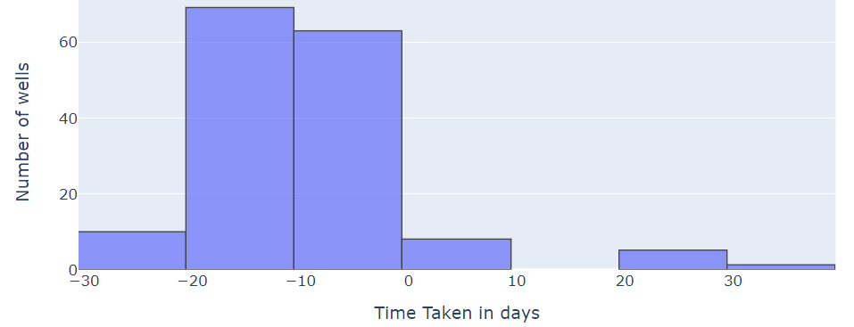
Model : Cycle Time Model - EDA
Well Completion to First Production Cycle Time

Slide 13


Model : Cycle Time Model
Findings
Mean Value of spud to rig release is 66 days.
Mean value of rig release to completion is 108 days.
In general, we are getting completion to first prod time as negative, so we are assuming first prod date as completion date.
Assumptions
Multiple API14 instances are linked to a single API10, and we are selecting the API10 for which the associated API14 has the maximum lateral length.
There are various outliers associated with different cycle times, So we are just opting for the median value for each completion.

Slide 14

Rig Model
Rigs Model
Based on Shea’s rig table, the rig model obtains schedules for all currently active rigs in the Gulf Coast East Basin. This information will be instrumental in planning the drilling of the next set of inventories.
At this point, the rigs are assumed to be constant per operator in a Type curve area
This model forecasts the number of rigs in a type curve for a specific operator.

Slide 15
Rig Model
Findings
Total current active rigs in Gulf Coast East Basin= 63
Total unique type curves where rigs are currently available = 23
The total number of distinct operators that currently have rigs in the Gulf Coast East Basin is = 15
There are occasions when we have more than one active rig assigned to a single operator within a type curve area.
There were 11 instances of combinations of TCA and operator for which we don't have cycle time data. In these cases, median value of operator from the whole basin is used for cycle time estimations.
Assumptions
Number of rigs per operator per Type curve area remains constant in the future.
In the rig's scheduler, rigs can be moved to any location in the type curve area without considerations of distance.

Slide 16
Model : Driller and Scheduler Model
Drilling and Scheduling
This model possesses the capability to retrieve drilling, completions, and production dates for inventory wells within a type curve area, utilizing the assistance of both the rig model and cycle time model.
This model identifies the dates for drilling, completion, and production of wells (WIPs and Undev).

Slide 17
Model : Driller and Scheduler Model
Data Sources
Inventory Data
Economics Data
10993
API10
10987
API 10
2617
API 10
Well Oneline
Economic Scenarios Undeveloped
Scenario= Base Scenario & basin=GULF COAST EAST
Dropping rows for which IRR is
missing
Key Highlights
Total unique API10 = 2617
Total unique Operators = 15
Total unique Type Curve Area = 23.
Merging with current rig information

Slide 18


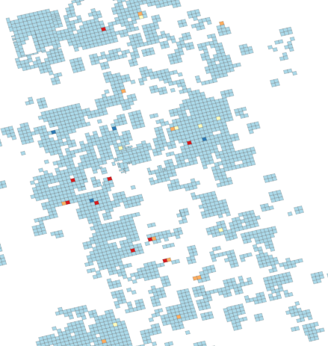
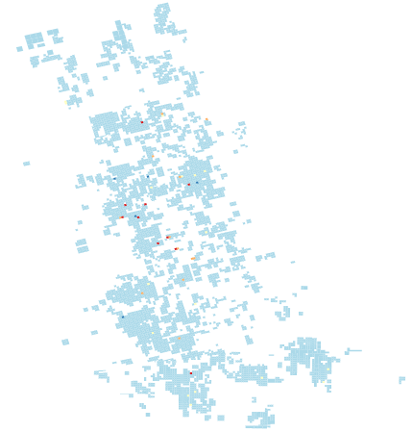




Model : Drilling and Scheduling Model
Gulf Coast East
One Type Curve Area
One Type Curve Area
One Type Curve Area
Ranking of Inventory
Based on IRR
Checking the earliest
Available rig
Adding 10 days buffer for rig move
Simultaneously updating the
Inventory list and rig available
list

Slide 19




Model : Production Estimation Model
Producing Wells
New Wells
WIP Wells
Sticks
Production estimation
This model forecasts the total amounts of oil, gas, and water production in the entire basin, as well as in each type curve, for a specified time.
Future Production Profile

Slide 20
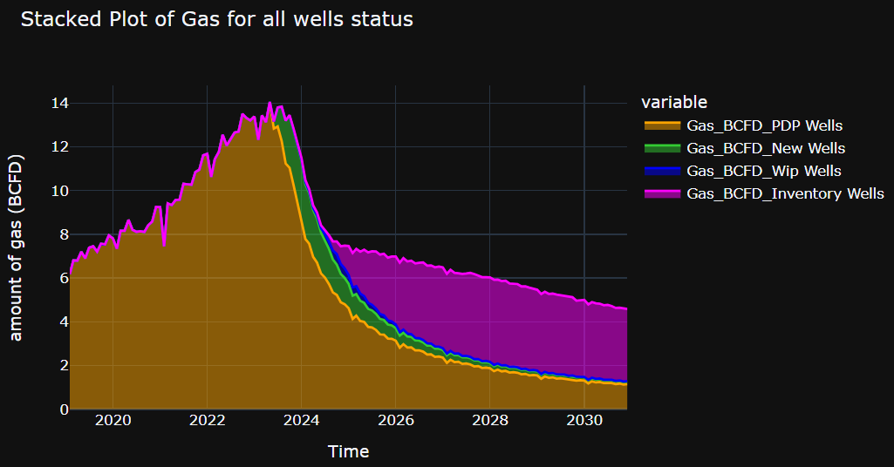
Model : Production Estimation Model
Amount of Gas For HAYNESVILLE reservoir

Slide 21
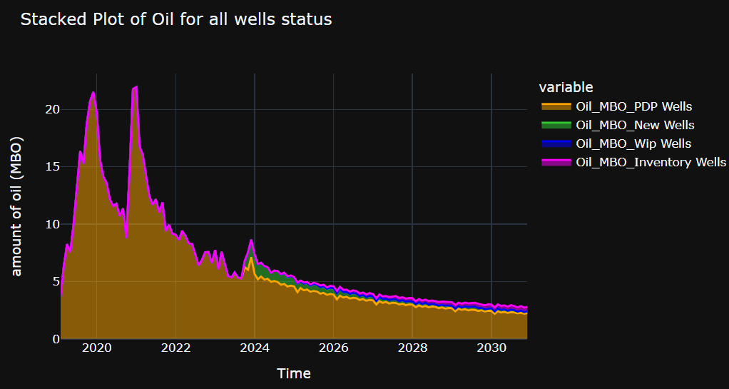
Model : Production Estimation Model
Amount of Oil For HAYNESVILLE reservoir

Slide 22
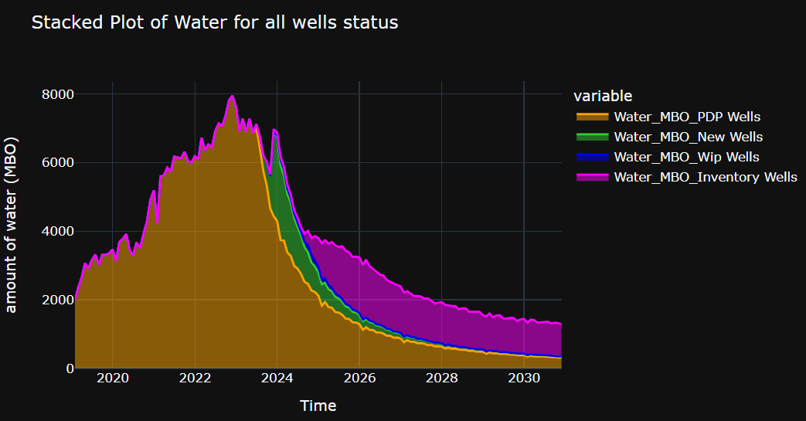
Model : Production Estimation Model
Amount of Water For HAYNESVILLE reservoir

Slide 23
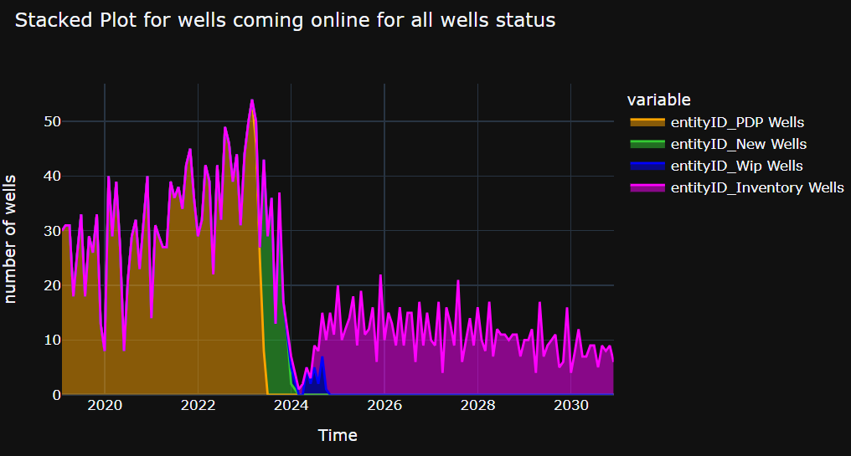
Model : Production Estimation Model
Number of Wells coming online for each well status for HAYNESVILLE reservoir with Time

Slide 24
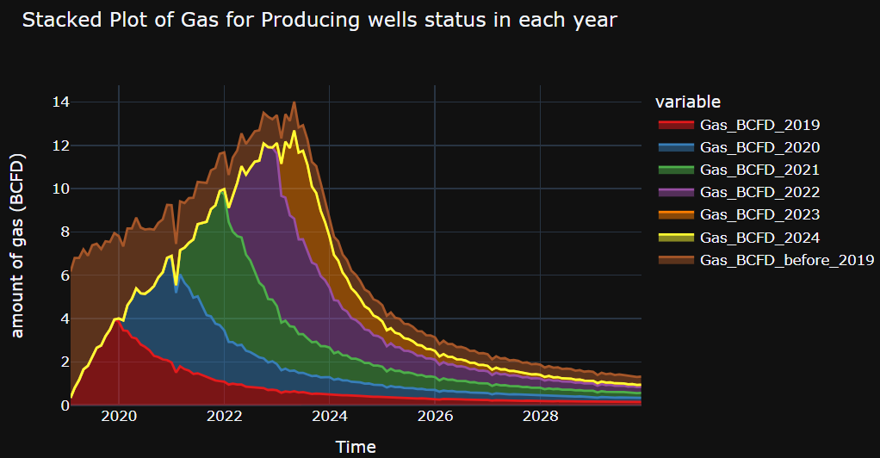
Model : Production Estimation Model
Amount of Gas for HAYNESVILLE reservoir for producing wells

Slide 25
Next Steps
In the field of economic data analysis, our model centers around the belief that the Internal Rate of Return (IRR) serves as the most appropriate metric for guiding decisions pertaining to the upcoming drilling operation. We can incorporate additional features to further refine the well-ranking process.
Our examination of rig data intentionally omits considerations for the future number of rigs in the type curve area associated with a specific operator. It is essential to shift our focus towards obtaining information on the future number of rigs.
Assuming equal distances between all locations and disregarding the impact of distance in the well selection process may not be prudent. The distance factor could significantly influence the choice of the next inventory well by rig.
In our cycle time calculations, we currently rely on historical data and select the median value. There is an opportunity to enhance this approach through the integration of machine learning, introducing more features into the analysis.

Slide 26
Thanks!

Slide 27
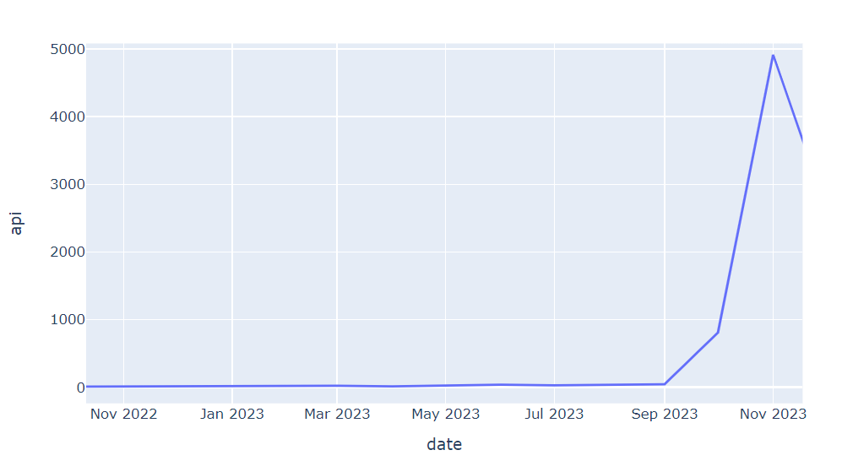
Last production date vs unique api count for pdp+new wells

Slide 28
Cycle Time | For Whole Basin | “CHK” Operator | “TGNR” Operator | “CHK” Operator and “HAYNESVILLE_HSVL_LA NFZ_SABINE” type curve | “CHK” Operator and “BOSSIER_HSVL_LA NFZ_NATCHITOCHES ” type curve
Time taken Permit Submit to approval | 9 days | 8 days | 10 days | 9 days | 8 days
Time taken permit approval to spud | 50 days | 50 days | 79 days | 11 days | 50 days
Time taken spud to rig release | 66 days | 66 days | 63 days | 70 days | 66 days
Time taken spud to completions | 174 days | 168 days | 156 days | 217 days | 168 days
Time taken completion to first production | -10 days | -8 days | 15 days | -2 days | -8 days

Slide 29
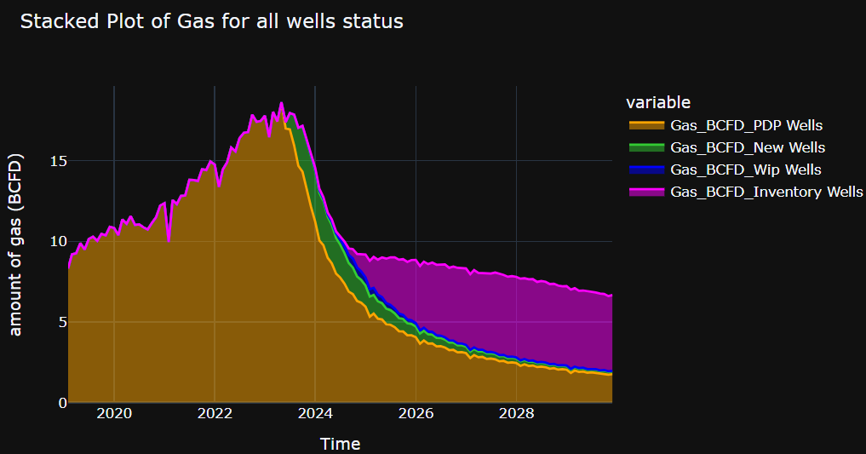
Amount of Gas For whole Basin

Slide 30
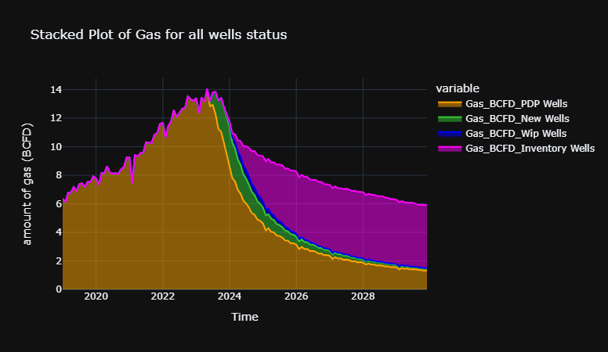
Amount of Gas For HAYNESVILLE reservoir after updating spud to rig release time
Spud to rig release median value = 34 days (earlier 66 days)

Slide 31
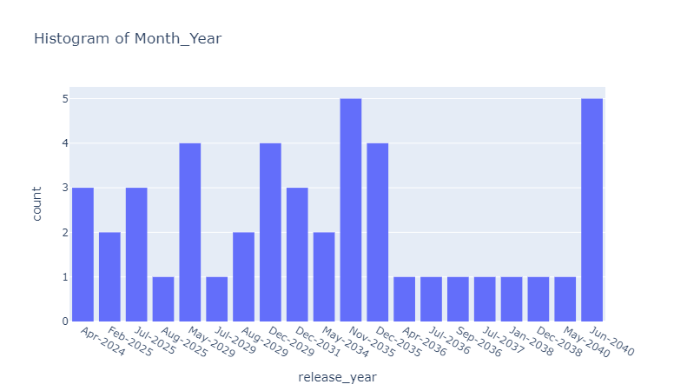
Active rigs vs time, with v0 logic (rigs are confined to opr * tca)

Slide 32
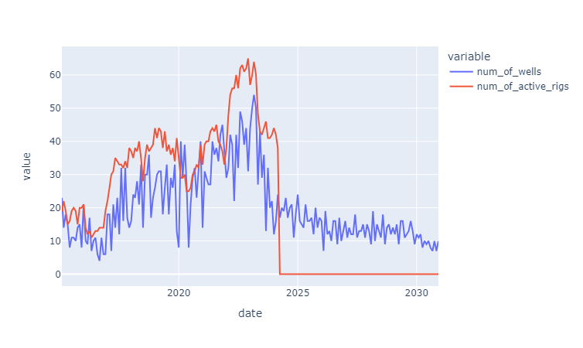
Num of active rigs and number of wells coming online
Vs
Time

Slide 33
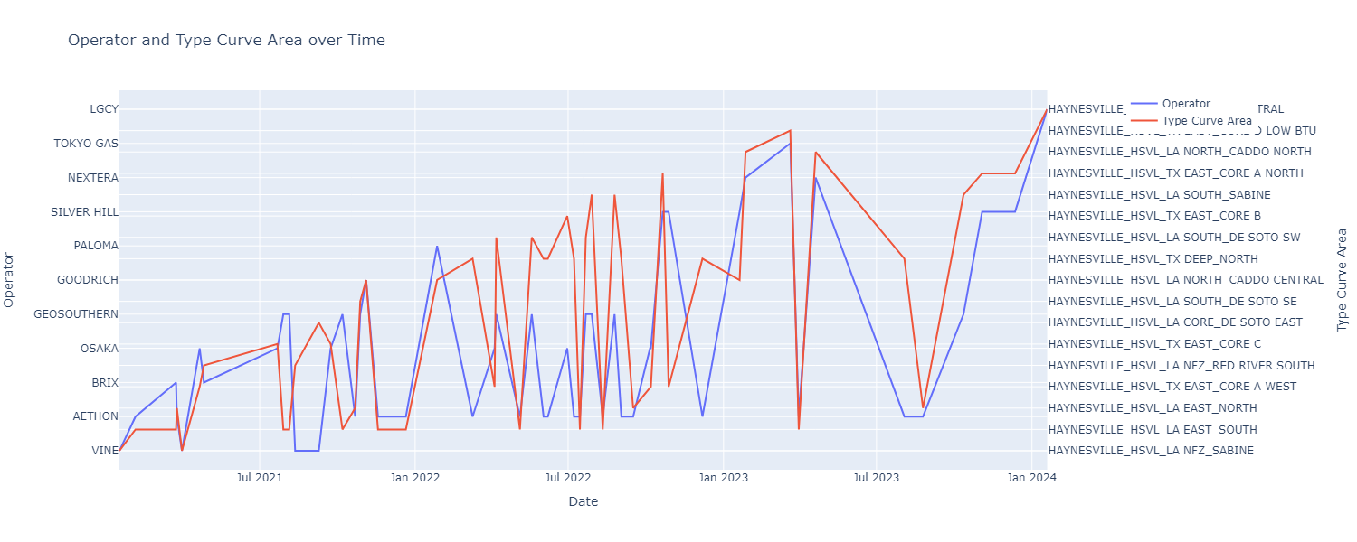
Rig Id = 3573
Total api = 53
Time filter> Jan 2021

Slide 34
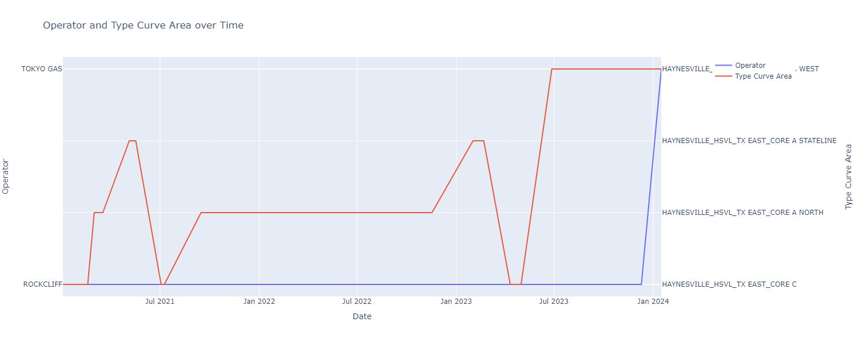
Rig Id = 3046
Total api = 44
Time filter> Jan 2021

Slide 35
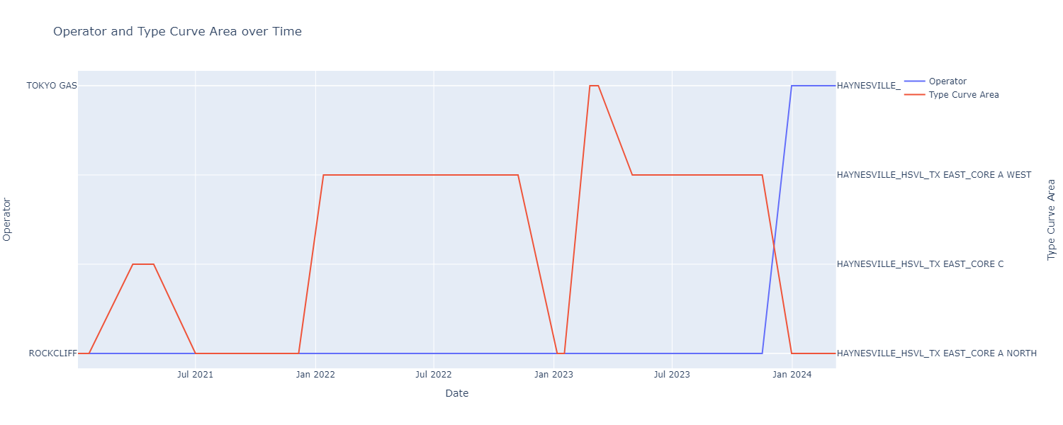
Rig Id = 2337
Total api = 41
Time filter> Jan 2021

Slide 36
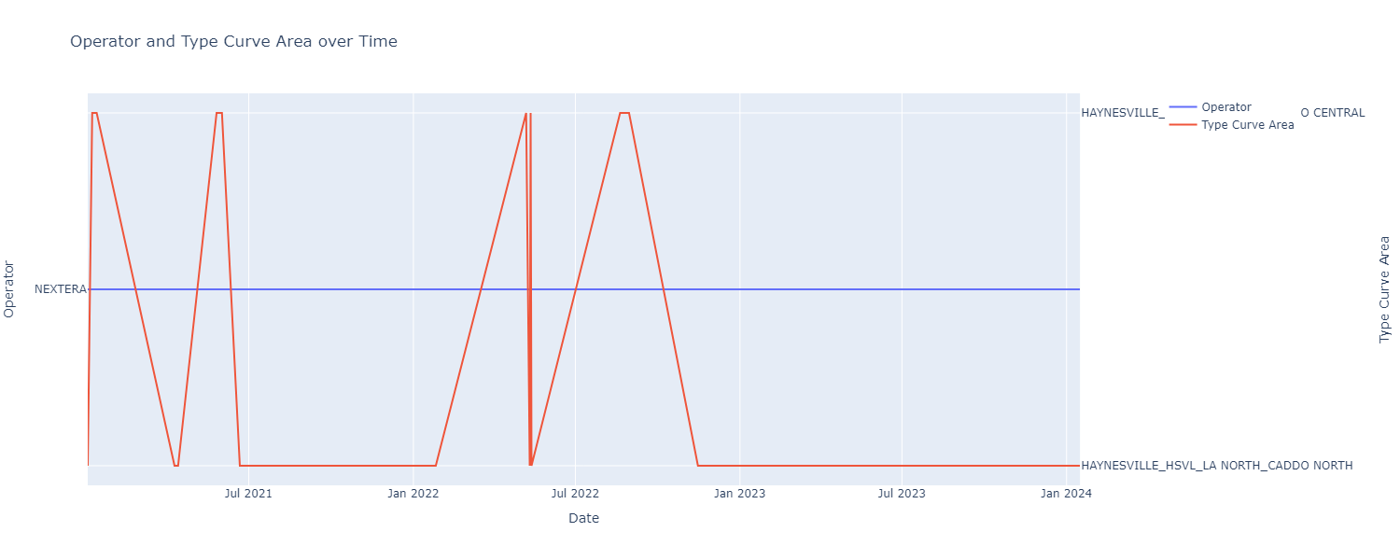
Rig Id = 101
Total api = 40
Time filter> Jan 2021

Slide 37
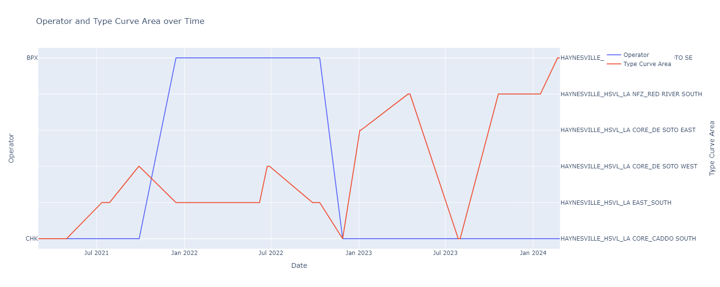
Rig Id = 1129
Total api = 34
Time filter> Jan 2021

Slide 38
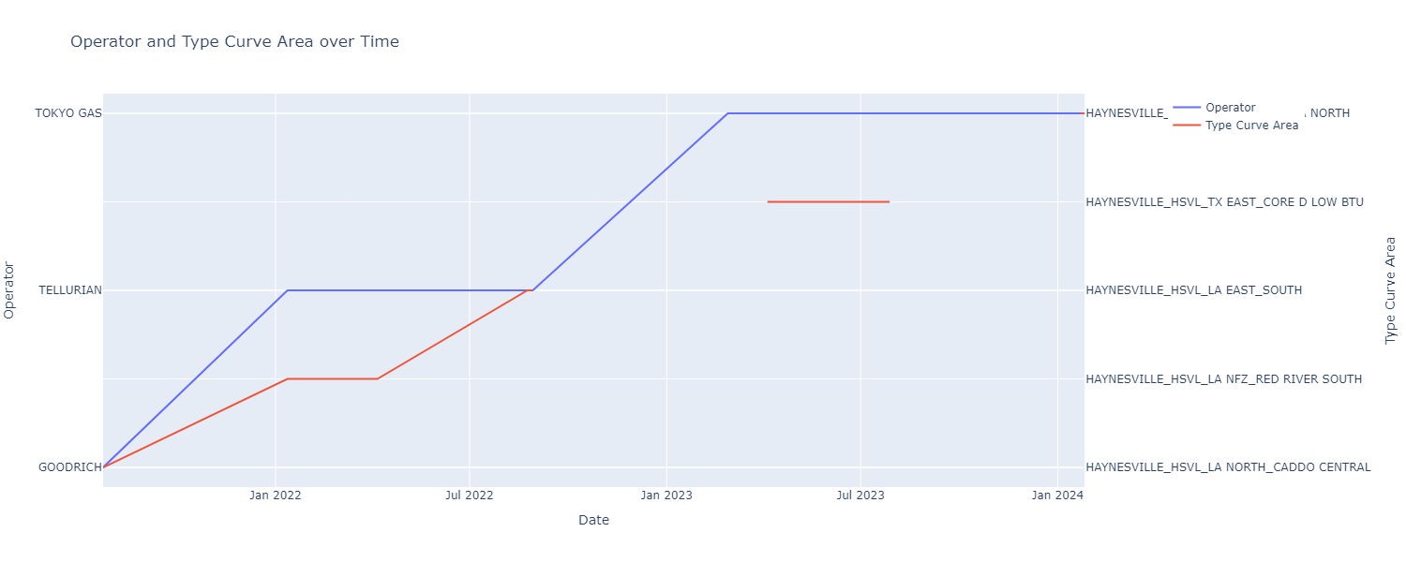
Rig Id = 6508
Total api = 22
Time filter> Jan 2021

Slide 39
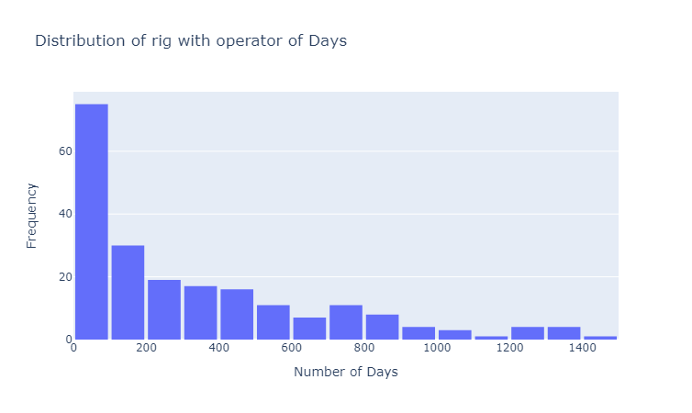
distribution of consecutive duration in days during which a rig was under the same operator.
Time filter> Jan 2021

Slide 40
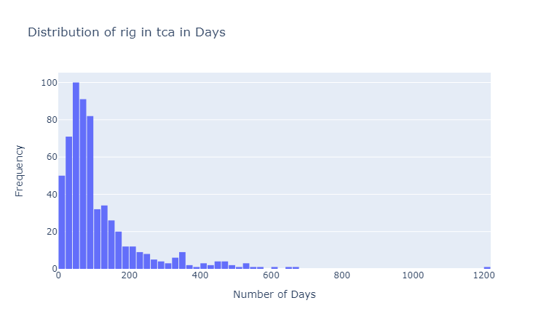
distribution of consecutive duration in days during which a rig was under the same tca.
Time filter> Jan 2021

Slide 41
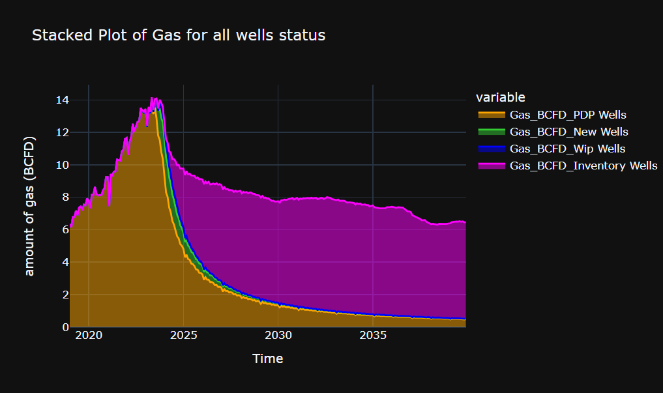
Amount of Gas For HAYNESVILLE reservoir after updating spud to rig release time
And inventory drilling and scheduling model

Slide 42
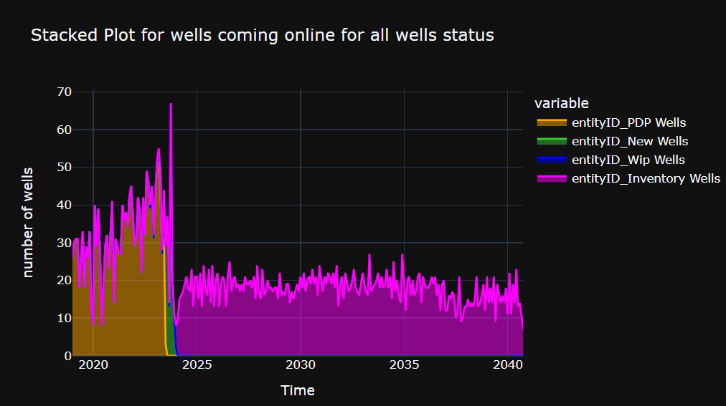
Wells coming online For HAYNESVILLE reservoir after updating spud to rig release time
And inventory drilling and scheduling model

